Slide 1
UNIVERSAL COLLEGE OF ENGINEERING
&
TECHNOLOGY
1ST SEM (MECHANICAL ENGINEERING)
ELEMENTS OF MECHANICAL ENGINEERING (211006)
Enrollment No. 130460119061
Enrollment No. 130460119062
Enrollment No. 130460119063
Enrollment No. 130460119064
Enrollment No. 130460119065
Guided By..
Mr. Ghanshayam Patel

Slide 2
Refrigeration & Air Conditioning

Slide 3
Air Conditioning.

Slide 4
TYPES OF AIR CONDITIONERS
1.Room air conditioners
2.Central air conditioning systems
3.Heat pumps
4.Evaporative coolers

Slide 5
Room air conditioner
Room air conditioners cool rooms rather than the entire home.
Less expensive to operate than central units
Their efficiency is generally lower than that of central air conditioners.
Can be plugged into any 15- or 20-amp, 115-volt household circuit that is not shared with any other major appliances

Slide 6
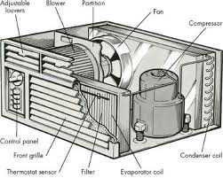

Slide 7
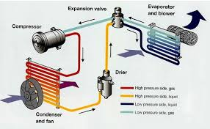

Slide 8
Central Air conditioning
Circulate cool air through a system of supply and return ducts. Supply ducts and registers (i.e., openings in the walls, floors, or ceilings covered by grills) carry cooled air from the air conditioner to the home.
This cooled air becomes warmer as it circulates through the home; then it flows back to the central air conditioner through return ducts and registers

Slide 9
Types of Central AC
split-system
an outdoor metal cabinet contains the condenser and compressor, and an indoor cabinet contains the evaporator
Packaged
the evaporator, condenser, and compressor are all located in one cabinet

Slide 10
Energy Consumption
Air conditioners are rated by the number of British Thermal Units (Btu) of heat they can remove per hour. Another common rating term for air conditioning size is the "ton," which is 12,000 Btu per hour.
Room air conditioners range from 5,500 Btu per hour to 14,000 Btu per hour.

Slide 11
Energy Saving Methods
Locate the air conditioner in a window or wall area near the center of the room and on the shadiest side of the house.
Minimize air leakage by fitting the room air conditioner snugly into its opening and sealing gaps with a foam weather stripping material.

Slide 12
Refrigeration System

Slide 13
Introduction
The mechanism used for lowering or producing low temp. in a body or a space, whose temp. is already below the temp. of its surrounding, is called the refrigeration system.
Here the heat is being generally pumped from low level to the higher one & is rejected at high temp.

Slide 14
Refrigerator & Refrigerant
A refrigerator is a reversed heat engine or a heat pump which takes out heat from a cold body & delivers it to a hot body.
The refrigerant is a heat carrying medium which during their cycle in a refrigeration system absorbs heat from a low temp. system & delivers it to a higher temp. system.

Slide 15
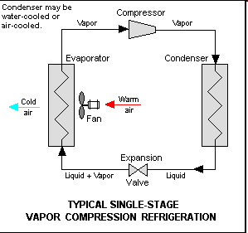

Slide 16
Vapour Compression Refrigeration
This is the most important system from the point of commercial & domestic utility & most practical form of refrigeration.
The working fluid refrigerant used in this refrigeration system readily evaporates & condenses or changes alternatively between the vapour & liquid phases without leaving the refrigerating plant

Slide 17
Contd….
During evaporation it absorbs heat from the cold body or in condensing or cooling it rejects heat to the external hot body .
The heat absorbed from cold body during evaporation is used as its latent heat for converting it from liquid to vapour.
Thus a cooling effect is created in working fluid.

Slide 18
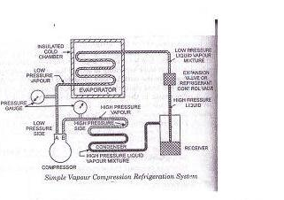

Slide 19
Contd….
This system of refrigeration thus act as latent heat pump since its pump its latent heat from the cold body or brine & rejects it or deliver it to the external hot body or the cooling medium.
According to the law of thermodynamics , this can be done only on the expenditure of energy which is supplied to the system in the form of electrical energy driving the compressor.

Slide 20
Advantages
Smaller size for a given refrigerating capacity
Higher coeff. of performance
Lower power requirements for a given capacity
Less complexity in both design & operation
It can be used over large of temp.

Slide 21
Electrical Circuit
Refrigerator is provided with a door push switch, which closes on opening of refrigerator and puts the lamp on.
Capacitor start single phase induction motor is used in open type refrigerators and split phase induction motor is used in sealed unit refrigerators.
Electromagnetic relay is provided to connect auxiliary winding on the start & disconnect it when the motor picks up the speed.

Slide 22
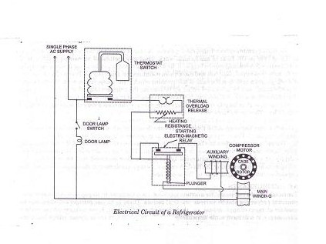

Slide 23
Contd…..
Thermal overload release is provided to protect the motor from damage against flow of over current.
Thermostat switch is provided to control the temp. inside the refrigerator.
Temp. inside the refrigerator can be adjusted by means of temp. control screw.

Slide 24
Contd…
To protect the motor against under voltage use of automatic voltage regulator is essential since in case of fall in applied voltage, motor will draw heavy current to develop the required torque and will become hot, thermal overload relay will therefore repeatedly disconnect and connect the motor to supply, eventually burning it out.

